Slide 1
Cryptography
Asymmetric cryptography

Slide 2
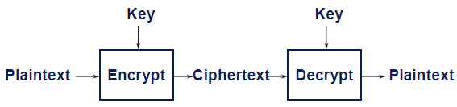
Motivation
Problem with symmetric crypto-system
Requires key exchange: difficult in practice
Authentication/non-repudiation: how to verify that a message comes intact from the claimed sender? Impossible to achieve
Asymmetric crypto-system: a public / private key pair is used
public key known to everyone
private key known only by owner
Much slower to compute than secret key cryptography

Slide 3
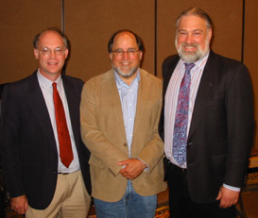
History
1977: separates classical and modern eras
Whitfield Diffie and Martin Hellman
Public-key encryption schemes
Diffie-Hellman key agreement protocol
Digital signature
Turing Award 2015: For fundamental contributions to modern cryptography. Diffie and Hellman's groundbreaking 1976 paper, "New Directions in Cryptography," introduced the ideas of public-key cryptography and digital signatures, which are the foundation for most regularly-used security protocols on the internet today.
Ron Rivest, Adi Shamir, Len Adleman
RSA algorithm: Turing Award 2002

Slide 4
History*
James Henry Ellis (1924-1997):
British engineer & cryptographer
Born in Australia, grown up in Britain, orphan
Worked at Government Communications Headquarters (GCHQ)
1970: proposed the concept of public-key crypto
Same idea of RSA
Kept secret by GCHQ
1973: with Clifford Cocks and Malcolm Williamson, developed a key distribution scheme
Similar as Diffie-Hellman key agreement protocol
Kept secret by GCHQ
1976: denied publication by GCHQ again
Diffie travelled to Britain to see Ellis
Dec. 1997: public announcement of their work, Cocks delivered a talk
Nov. 1997: death of Ellis
2016: GCHQ director emphasized contribution of Ellis, Cocks, Williamson
Notes:
伦敦东区长大，小时候被认为智力滞后，数学天才

Slide 5
Misconception of asymmetric systems
Asymmetric encryption is more secure than symmetric ones
Public-key encryption is a general-purpose technique that has made symmetric encryption obsolete
Key distribution is trivial in public-key encryption

Slide 6
Asymmetric system requirements
Computationally
easy to generate a public / private key pair
hard to determine private key from public key
Computationally
easy to encrypt using public key
easy to decrypt using private key
hard to recover plaintext from ciphertext and public key

Slide 7
Trapdoor one-way function
Trapdoor one-way function
Y=f_{k}(X): easy to compute if k and X are known
X=f⁻¹_{k}(Y): easy to compute if k and Y are known
X=f⁻¹_{k}(Y): hard if Y is known but k is unknown
Goal of designing asymmetric algorithm is to find appropriate trapdoor one-way function

Slide 8
RSA
The most popular public key method
Encryption and signature
Mathematic basis:
factorization of large numbers is hard
Variable key length (1024 bits or greater)

Slide 9
A mini-math detour: modular arithmic
a mod n
the rest of a divided by n
E.g., 23 mod 7 = 2
Some properties
a + b mod n = a mod n + b mod n
a * b mod n = (a mod n) * (b mod n)
7²⁵ mod 10 = ?

Slide 10
Greatest Common Divisor
gcd(576, 135) = gcd(135, 36) = gcd(36, 27) = gcd(27, 9) = 9
Euclidean algorithm
576 = 4 * 135 + 36
135 = 3 * 36 + 27
36 = 1 * 27 + 9
27 = 3 * 9 + 0

Slide 11
Extended Euclidean algorithm
Theorem: given nonzero a and b, there exist x and y such that
ax + by = gcd(a, b)
Linear Diophantine equation in two variables
Proof: extended Euclidean algorithm (576,135)
Notes:
证明

Slide 12
Division mod n
Corollary: if gcd(a, n) = 1, then there exists x
such that ax = 1 mod n
x=1/a mod n: division mod n
Possible if gcd(a, n) = 1
Proof
For any a, b, there exists x, y
ax + by = gcd(a, b)
Let b=n: ax+bn=1
ax = 1 mod n
Notes:
证明

Slide 13
Division mod n: example
Solve 5x = −4 mod 11
Possible: gcd(5, 11) = 1
Run extended Euclead algorithm
−2*5 + 1*11 = 1 implies −2 = 1/5 mod 11
5x = −4 mod 11
-2*(5x)=8 mod 11
-11x+x=8 mod 11
x=8 mod 11
Counterexample: solve 5x = −4 mod 10
Impossible: gcd(5, 10) = 5
Notes:
证明

Slide 14
Fermat's little theorem
Given a prime p, an integer a non divisible by p, we have
a^{p-1} mod p = 1
Proof
a*i != a*j mod p, hence (a*1)(a*2)...(a*(p − 1)) = (p − 1)! mod p
Exemple: p=3, a=2, 2³⁻¹ mod 3 = 1
Notes:
证明

Slide 15
Euler’s totient function φ(n)
φ(n) is the number of integers 1 ≤ x ≤ n such that gcd(x, n) = 1
φ(p) = p − 1 if p is prime
φ(pq) = (p − 1)(q − 1)
Exemple: φ(10) = 4
Euler’s theorem: if gcd(a, n) = 1, then a^{φ(n)} = 1 mod n
Proof: for x_{i}, x_{j} co-prime to n: a*x_{i} != a*x_{j} mod n,
Hence (a*x₁)(a*x₂)...(a*x_{φ(n)}) = x₁*x₂*... *x_{φ(n)} mod n
Generalization of Fermat's little theorem
Given 2 primes p, q, and a mod (p-1)(q-1) = 1, we have
xª mod pq = x, for any x < pq
Proof ?
Example : a=9, p=3, q=5, pq=15, (p-1)(q-1)=8
x=1 : 1⁹ mod 15 = 1
x=2 : 2⁹ mod 15 = 512 mod 15 = 2
End of math mini-detour
Notes:
证明

Slide 16
RSA algorithm
M: plaintext;
C: ciphertext
Encryption
C = Me mod n
Decyption
M = C^{d} mod n
Public key
(e,n)
Private key
(d,n).

Slide 17
RSA: key setup
Find large primes p and q
Let n = p*q
do not disclose p and q!
Choose an e that is relatively prime to (p-1)(q-1)
public key = (e,n)
Find d such that e*d mod (p-1)(q-1) = 1
private key = (d,n)
Encryption
C = Me mod n
Decryption
M’ = C^{d} mod n = (Me)^{d} mod n = M^{ed} mod n = M
Following Fermat's theorem

Slide 18
RSA: example
p=3, q=11
n=pq=3*11=33
(p-1)(q-1)=2*10=20
e=3, d=7, ed mod (p-1)(q-1) = 1
3*7 mod 20 = 1
M = 29
C=Me mod n=29³ mod 33=2
M’=C^{d}=2⁷ mod n=29=M
Test : p=5; q=11, e=3; M=4
Notes:
普法战争法国战败的产物

Slide 19
RSA: Security
Public key (e,n) is public information
If one could factor n into p*q, then
could compute (p-1)(q-1)
could compute d = e⁻¹ mod (p-1)(q-1)
would know private key (d,n)!
But: factoring large integers is hard!
Classical problem worked on for centuries; no known fast method
Test: try to factor 2419 ? 373247 ?? 96171919154952919 ???
Is RSA as strong as factorization?
Notes:
100225441* 959555959

Slide 20
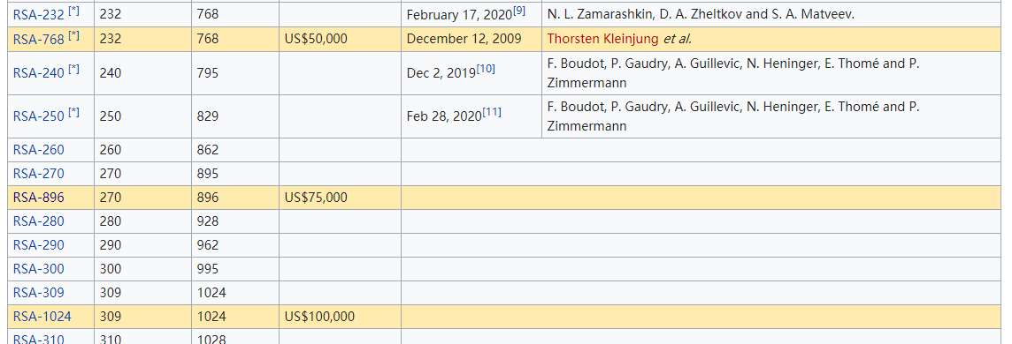
RSA Factoring Challenge
Launched by RSA Lab in 1991

Slide 21
RSA: Security
At present, key sizes of 1024 bits are considered secure
but 2048 bits is better
Tips for making n difficult to factor
p and q lengths should be similar (ex.: ~500 bits each if key is 1024 bits)
but not too close
Fermat factorization method: n = x² − y² = (x + y)(x − y)
both (p-1) and (q-1) should contain a “large” prime factor
Pollard (p − 1) factorization
gcd(p-1, q-1) should be “small”
d should be larger than n^{1/4}

Slide 22
RSA implementation
Select primes p and q
In practice, select random numbers, then test for primality
Prob. a randomly chosen number n being prime ≈ 1/ln(n)
Many implementations use the Rabin-Miller test
Fermat test: theory
Fermat's little theorem: for prime p: a^{p-1} = 1 mod p
Fermat test: algorithm
For i=1 to k
pick a randomly
if a^{n-1} != 1 mod n output “n is composite”
EndFor
output “possible prime”

Slide 23
Carmichael numbers
Carmichael numbers are composites that can pass Fermet test
Bad news: there are infinite many Carmichael numbers
First three: 561, 115, 1729

Slide 24
RSA implementation
Select e
e is usually chosen to be 3 or 2¹⁶+ 1 = 65537
Binary: 11 or 10000000000000001
In order to speed up the encryption
the smaller the number of 1 bits, the better

Slide 25
Square-and-Multiply Algorithm

Slide 26
Compute d
ed mod (p-1)(q-1) = 1
Linear Diophantine equation in two variables
Extended Euclidean algorithm

Slide 27
Attacks against RSA: message guessing
Alice and Bob are lovers.
When they are happy, the message between them is often “I love you”
Otherwise, “I hate you”
Attacker can guess m and test each guess
because e is public
How to prevent this attack?
Include a random number in the message

Slide 28
Attacks against RSA: timing attack
如果有一轮的运算时间长：迷药的这一位可能为1；短：为0。
解决：增加随机延时，设计执行时间和输入独立的算法。

Slide 29
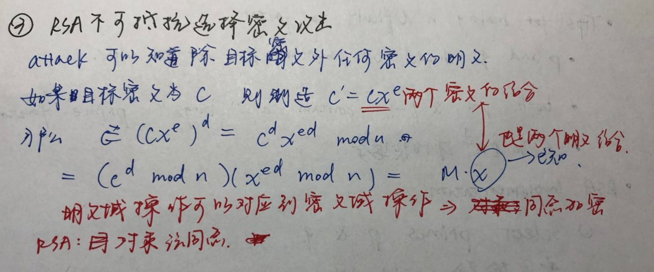
Test:
Show that RSA is not resistant against chosen ciphertext attack选择密文攻击：attacker可以知道除目标秘闻外任何密文的明文。
Attacker disposes C, can access any plaintext M' corresponding to C' as long as C' != C
Show that attacker can get M
RSA is homomorphic同态
明文域操作可以对应到密文域操作：同态加密
RSA：对乘法同态
Notes:
Faire déchiffrer le msg cx^e : (cx^e)^d mod n=c^dx^ed mod n=(c^d mod n)*x =mx

Slide 30
Hybrid system
Generate a session key
randomly-generated key for one communication session
Use a public key algorithm to send the session key
Use a symmetric algorithm to encrypt data with the session key

Slide 31
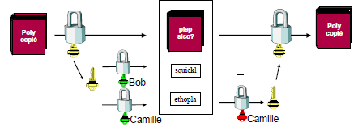
RSA application: mixed encryption
Send efficiently a encrypted message to multiple destinations
Use a secret key K to encrypt M
Encrypt K with public keys of destinations
Notes:
结合对称和非对称加密

Slide 32
Using RSA for secret key negotiation
A sends random number R₁ to B, encrypted with B’s public key
B sends random number R₂ to A, encrypted with A’s public key
A and B both decrypt received messages using their respective private keys
A and B both compute K = H(R₁||R₂), and use K as shared key

Slide 33
Block Ciphers Features
Block size
Key size
Number of rounds
Operation mode
How large messages are encrypted
Important for security
NIST defines five operation modes
Electronic codebook mode (ECB)
Cipher block chaining mode (CBC) – most popular
Cipher feedback mode (CFB)
Output feedback mode (OFB)
Counter mode (CTR)

Slide 34
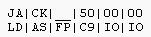
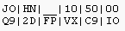
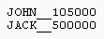
Electronic Code Book (ECB)
Only strength
Decrypt any block independently
Not secure
A file containing salairies
Using ECB

Slide 35

ECB: insecurity

Slide 36
Cipher Block Chaining (CBC)
Strength
The encryption of a block depends on current and blocks before
Repeated plaintext blocks are encrypted differently
Weakness
Errors in one block propagate to two blocks
error in C_{j} affects M_{j} and M_{j+1}
Encryption cannot be parallelized (decryption: yes)

Slide 37
Initialization Vector
Initialization Vector (IV)
Used along with the key; not secret
For a given plaintext, changing either the key, or IV, will produce a different ciphertext
IV generation and sharing
Random; may transmit with the ciphertext
Incremental; predictable by receivers

Slide 38
Cipher feedback mode (CFB)
这是异或XOR！！
Compare with OTP

Slide 39
Output feedback mode (OFB)
Pre-processing possible
Error propagation limited
IV: different per message

Slide 40
Counter Mode (CTR)

Slide 41
Operation mode: summary

Slide 42
Diffie-Hellman Protocol
For negotiating a secret key using only public communication
Does not provide authentication
Parameters: public information
p: a large prime (~512 bits)
g: a primitive root mod p, and g < p
<g> is a finite group of order p
g is a primitive root mod p if, for every number a relatively prime to p, there is an integer z such that a ≡ g^{z} mod p

Slide 43
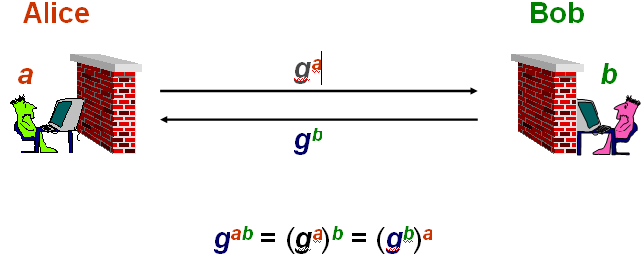
Diffie-Hellman Protocol
Alice picks a random number a, Bob b
Alice computes A = gª mod p, Bob B = g^{b} mod p
Alice and Bob exchange A et B
Alice computes Bª mod p = g^{ba} mod p, Bob A^{b} mod p = g^{ab} mod p
k = g^{ba} mod p is the secret key
Impossible to derive k from A and B: discrete log problem
given g, p et n, computationally infeasible to find a: gª mod p = A

Slide 44
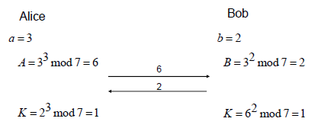
Diffie-Hellman example
g=3, p=7

Slide 45
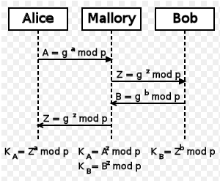
DH man-in-the-middle attack
DH limitation: not for user authentication
You may negotiate key with attacker!

Slide 46
DH: phone-book mode
Alice and Bob each chooses a secret number, generates A and B
Alice and Bob publish A and B
Alice can get Bob’s B at any time
Bob can get Alice’s A at any time
Alice and Bob can then generate key without communicating
but, they must be using the same p and g
Needs reliability of the published values
no one can substitute false values

Slide 47
Test: group DH
Alice, Bob, Carole need to negociate a secret key
Develop a DH-based protocol for them

Slide 48
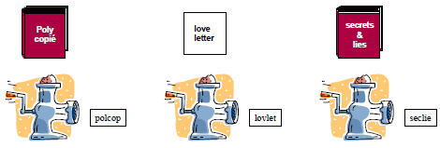
Hash function
Arbitrary-length input to fixed-length output

Slide 49
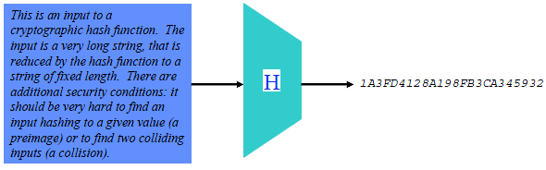
Hash function
Also known as
Message digest
One-way transformation
One-way function
Hash
Length of H(m) << m
Usually fixed lengths: 128 or 160 bits
McCarthy’s puzzle

Slide 50
Hash Function: desirable properties
Performance: Easy to compute H(m)
One-way property: given H(m), computationally infeasible to find m
Weak collision resistance: given H(m), computationally infeasible to find m’ such that H(m’) = H(m)
Strong collision resistance: computationally infeasible to find m₁, m₂ such that H(m₁) = H(m₂)

Slide 51
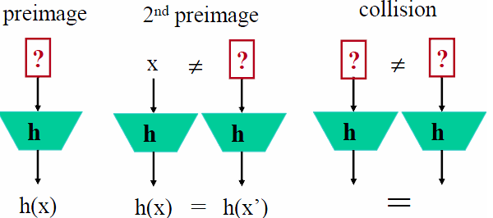
Hash Function: desirable properties
One-way property: resistance to pre-image
Weak collision resistance: resistance to second pre-image
Strong collision resistance: imply resistance to 2nd pre-image
Test: are they good hash functions
H(x) = a^{x} mod p; H(m) = m1+m2+…

Slide 52
Length of Hash Image
Why do we have 128 or 160 bits Hash image?
Too long: unnecessary overhead
Too short: collision
For k messages, what is minimal Hash image length such that
prob. that at least two messages have the same hash < 0.5?
Number of sand grains: 2⁷⁰

Slide 53
Birthday Paradox
What is the smallest group size k such that
Prob. at least two people having same birthday > 0.5
n=365 days
P(k people having k different birthdays)
P(at least two people having same birthday)
Back to our minimal Hash image length problem
k messages, n=2^{m} possible images
To have prob. of collision > 0.5
k>2^{m/2}

Slide 54
Hash Function Genealogy

Slide 55
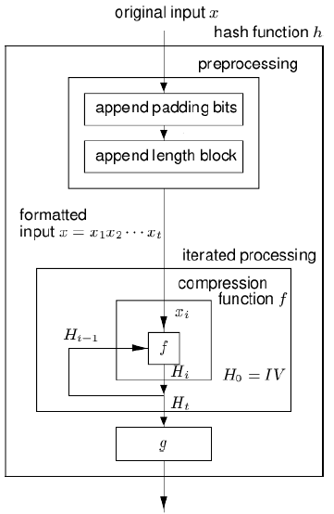
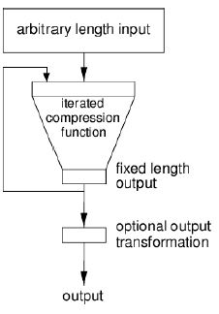
Hash function structure
Notes:
DES如何构造hash function，问题在哪里

Slide 56
Hash function application
Encryption
Protect confidentiality, but not integrity
Hash function
Integrity, authentication
Digital signature
......

Slide 57
File authentication
Objective: detect modification
Method
Stock H(f) separately as f
Check H(f)=H(f’)
Why not just store a duplicate copy of F?

Slide 58
User authentication
Alice wants to authenticate herself to Bob
assuming they already share a secret key k
Protocol
A->B : I’m Alice
B->A : R (random number)
A->B : H(R|k)
Why not just send k, in plaintext, or H(k)? Why using R?

Slide 59
Message authentication
Alice wants to authenticate a message to Bob
assuming they already share a secret key k
Protocol
A->B: M, R, H(M|k|R)

Slide 60
Commitment Protocol
A and B play game “odd or even” over the network
A picks a number X
B picks another number Y
A and B “simultaneously” exchange X and Y
A wins if X+Y is odd, otherwise B wins
If A gets Y before deciding X, A can easily cheat
How to prevent this?

Slide 61
Commitment Protocol
A should commit to X before B sends Y
Protocole :
1. A->B : H(X)
2. B->A : Y
3. A->B : X
Why is sending H(X) better than sending X?
Why is sending H(X) enough to prevent A from cheating?
Why not necessary for B to send H(Y) (instead of Y)?
What problems are there if:
The set of possible values for X is small?

Slide 62
Encryption with Hash
One-time pad
compute bit streams using h, k, and IV
b₁= h(k|IV), b_{i}= h(k|b_{i-1}), …
XOR with message blocks
Mixing in the plaintext: similar to cipher feedback mode (CFB)
b₁= h(k|IV), c₁= p₁ ⊕b₁
b₂= h(k|c₁), c₂= p₂ ⊕b₂

Slide 63
Hash Pointers
Hash pointer = { pointer, hash(data) }
allows to verify data has not been modified
the first hash pointer is protected
Blockchain

Slide 64
Merckle tree
Only need to examine O(log₂n) hashes to validate data

Slide 65
Digital signature
No need to encrypt whole message
Can ensure: integrity, authentication, non-repudiation

Slide 66
Test: signature
Alice uses the following signature scheme
Signature: s=[h(M)]^{d} mod n
(d,n): Alice's private key
Find a problem if hash is not used
s=(M)^{d} mod n

Slide 67
Cryptographic algorithm benchmark
Pentium II ™ 233 MHz, API BSAFE 4.0 de RSA
operation
performance
DES
: key generation
6 μsec
DES
: encryption
3241 Koctets/s
DES
: decryption
3333 Koctets/s
MD5
: hash generation
36 250 Koctets/s
RSA
: encryption
4,23 Koctet/s
RSA
: decryption
2,87 Koctet/s
SHA
: hash generation
36 250 Koctet/s

Slide 68
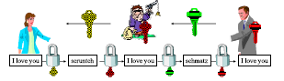
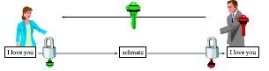
PKI: motivation
Alice wants to communicate with Bob
Problem: how to get the public key Bob
Man-in-the-middle attack

Slide 69
Certificate
A certificate is a signed message proving that a particular name goes with a public key
Example:
[Alice’s public key is 876234]_{carol}
[Carol’s public key is 676554]_{Ted}
A certificate is signed by a trusted third party
Contains following information
ID (name and address)
Public key
Expiration date
Signature of the certificate

Slide 70
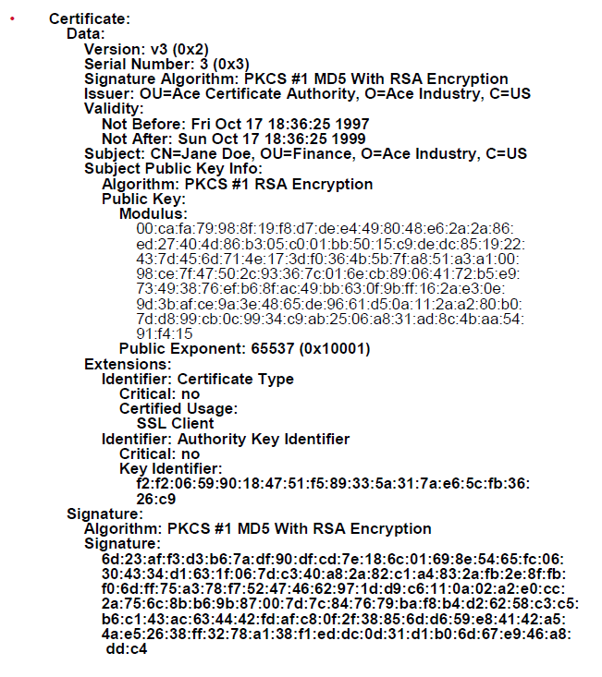
Certificate: example

Slide 71
Using certificate
A trusted third party Trent signs certificate of Bob
If Alice has public key of Trent, she can verify certificate of Bob
Alice trusts Trent

Slide 72
Issue and check certificate

Slide 73
Public key infrastructure (PKI)
An infrustructure containing all necessary components to securely distribute public keys
Certificate Authority (CA)
Certificates
Registration Authorities (RA)
A repository for retrieving certificates
A method of revoking/updating certificates

Slide 74
Certification Authorities (CA)
A trusted entity maintaining public keys for all nodes
Each node maintains its own private key
CA authenticates each new participant Alice physically
Alice creates a pair of public, private keys
CA creates and signs certificate of Alice
A CA can be public or private
Mutiple CAs can form a trust chain

Slide 75
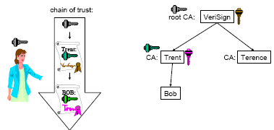
CA hierharchy

Slide 76
Registration Authorities (RA)
CA can delegate registration of new participants to RAs
RA does not have private key of CA
Cannot sign certificates
RA only authenticates physically new participants
RAs check identities and provide CA with relevant information (identity and public key) to generate certificates

Slide 77
Certificate Revocation
Certificates may need to be revoked
Someone is fired
Someone is graduated
Someone’s certificate (card) is stolen
CA maintain a Certificate Revocation List (CRL)
CRL issued periodically by CA, containing revoked certificates
Each transaction is checked against CRL

Slide 78
Web of Trust
Problem of PKI
Centralized hierarchic model
Cannot have a CA for the whole world!
Web of trust
Philosophy: trust friend’s friend
Trust = sign one's certificate

Slide 79
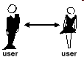
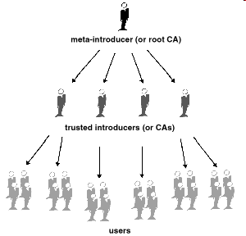
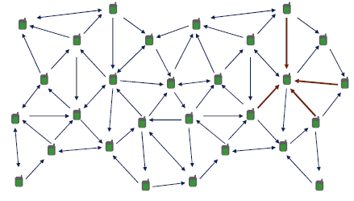
Trust models
Direct trust
Hierarchical trust
Web of trust

